Slide 1
Functions
A block of code which performs a specific task called function.
We use functions to divide a complex problem into smaller chunks.
Makes program easy to run and re-usable.
def function_name():
#contents

Slide 2
Function Arguments -
def test_func(V1):
print(V1)
def add(V1,V1):
print(V1+V2)

Slide 3
Function Return Statement -
def add(V1,V1):
return V1+V2
x = add(3,4)

Slide 4
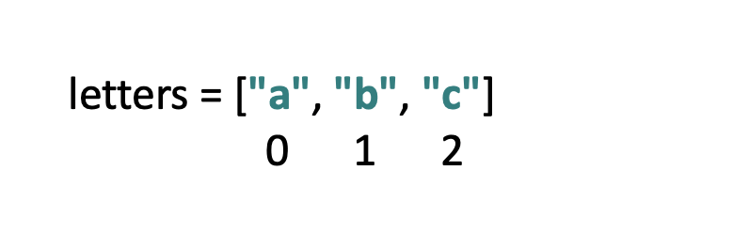
Lists
Lists are used to store multiple values in a single variable
Lists are created using square brackets
Items in a list are ordered
Every item has a positive and negative index

Slide 5
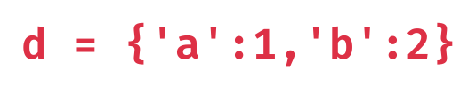
Dictionaries
Dictionary is an ordered collection of items
It stores elements in key/value pairs.

Slide 6
While Loop
While loop used to run specific code until a certain condition is True
while condition:
#contents
i = 0
while i < 3:
print(“x”)
i += 1

Slide 7
break statement in while loop
We can use break statement to end while loop permanently
i = 0
while i < 3:
print(“x”)
i += 1
if i == 2:
break

Slide 8
continue statement in while loop
We can use continue statement to stop the current iteration of while loop and continue with the next iteration
i = 0
while i < 4:
if i == 2 :
i += 1
continue
print(i)
i += 1

Slide 9
For Loop
for loop used to run block of code specific number of times
for var in sequence:
#contents
Here var access each item of sequence in each iteration

Slide 10
list = [0,1,2,3,4,5]
for i in list:
print(i)
We can use range() function to generate a list of values between 2 intervals
numbers = range(6)
for i in numbers:
print(i)

Slide 11
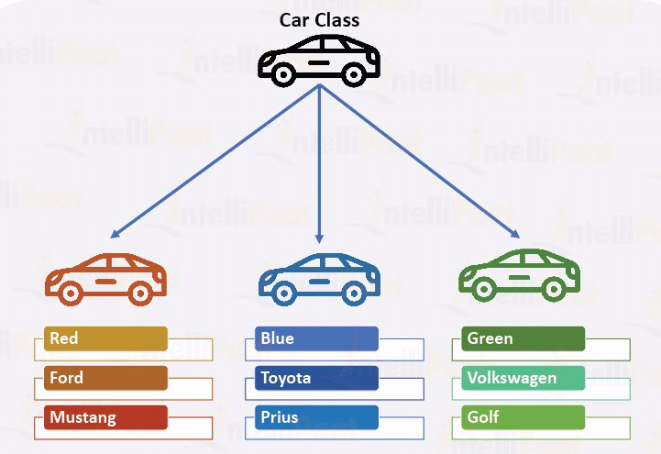
Classes and Objects
An object in python is a collection of variables(properties) and functions(methods)
Class is a blueprint for creating objects. We can create many objects from same class.
Therefore we called objects are the instances of a class.

Slide 12
class Car:
def _ _init_ _(self,color,brand,model):
self.color = color
self.brand = brand
self.model = model
car1 = Car(“red”,”ford”,”mustang”)
car2 = Car(“blue”,”toyota”,”prius”)
car3 = Car(“green”,”volkswagon”,”golf”)

Slide 13
class Car:
def __init__(self,color,brand,model):
self.color = color
self.brand = brand
self.model = model
def get_details(self):
print(self.color,self.brand,self.model)
car1 = Car(“red”,”ford”,”mustang”)
car1.get_details()

